Slide 1
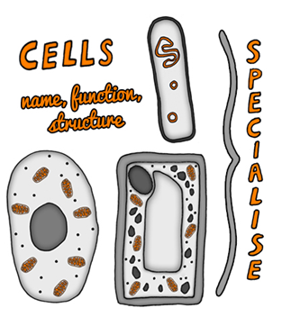
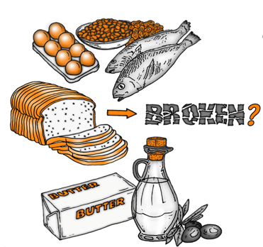
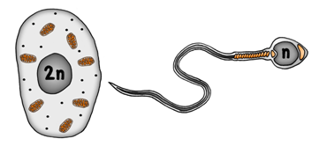

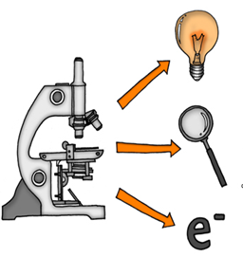
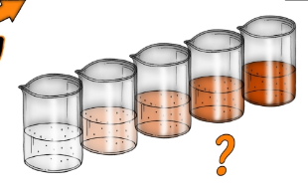



Edexcel GCSE Key Concepts in Biology
ThinkIT!
© Copyright The PiXL Club Ltd, 2017

Slide 2
Cell structure:
Compare the sub-cellular structures of eukaryotic and prokaryotic cells.
Explain how the main sub-cellular structures are related to their function.
Compare the size of eukaryotic and prokaryotic cells and discuss relative size of the sub-cellular structures.
Find typical sizes for several structures within cells and quote the sizes using standard form.
Core practicals:
Why do scientists calculate the percentage change in mass when analysing the results of the osmosis in potato chips practical?
Do old potatoes make better chips? Discuss your ideas.
Is osmosis the same as diffusion?
What are the limitations of the food test experiments?
Section name:
Osmosis:
Which part of a plant cell is fully permeable and which is partially permeable?
How can plasmolysis be brought about?
Prize pumpkin growers sometimes inject a concentrated sugar solution into the pumpkin. Explain why. Do you think this is cheating?
Does the potato chip in the osmosis investigation have to be raw?
Section name:
Specialised cells:
How much bigger is the human egg cell than a human sperm cell? Why?
What is the difference between bacterial chromosomal DNA and plasmid DNA?
Explain to your neighbour the definition of haploid and diploid.
Describe how a sperm cell is able to penetrate the egg cell membrane.
What conditions must be carefully controlled in an IVF lab to maximise the chance fertilisation occurs and the resulting cell is not damaged in any way?
Edexcel GCSE
Key Concepts in Biology
ThinkIT!
Digestive enzymes:
Enzyme action is affected by pH and temperature. Explain why this is determined by the 3D protein structure
History shows evidence of pre-mastication which is where mothers chew food before giving it to their babies. Suggest why mothers may have done this.
Explain why a 10°C rise in temperature may result in a doubling of the rate of an enzyme controlled reaction prior to the enzyme becoming denatured.
© Copyright The PiXL Club Ltd, 2017
Microscopy:
Discuss the structure and function of the light and electron microscope.
Compare the cell structures that can be seen by the light and electron microscope and discuss the resolution of each instrument.
Explain why the development of the electron microscope was important.
Explain how to use a light microscope to observe and measure cheek cells.
Enzymes continued:
What is an immobilised enzyme?
How are chocolates made that have runny centres?
What causes some people to be lactose intolerant?
Is it an economical advantage to use biological washing powder instead of a non-biological type?
Why do enzyme experiments often include the use of a buffer solution?
Section name:
In the term calorimetry what is the derived meaning of ‘calor’ and ‘metry’?
How is calorimetry used in the real world?
Research the case study of a man called Alexis St Martin. How did his treatment move forward knowledge of enzymes and the human digestion system?

